Slide 1
بسم الله الرحمن الرحيم
Selected Labs in Software Engineering project
[[ medical clinic management system ]]
dr : Mahmoud Bassiouni
M : mohamed hussien

Slide 2
Team member :-
1-Srabamon Ashraf Fawzey ID:2101652
2-mohammed hussien ahmed ID:2101275
3-Mahmoud Ashraf Gaber ID:2101282
4-mohammed ahmed maged ID:2101255
5-Remon Sobhy Sadek ID: 2101498

Slide 3
Introduction :-
This document describes the design and implementation of a desktop
application for managing patient records, doctor schedules,
appointments and medical history using Java. Singleton pattern,
Factory pattern and three other patterns are used in this design which
are observer and adapter and Builder designe patterns.

Slide 4
What are design patterns
A design pattern is a reusable solution for common problems in software design used in engineering.
It is not a full design ready for coding but rather a guideline or model for solving issues. Design
patterns can be adapted to different situations and contexts, providing flexibility in problem-solving.

Slide 5
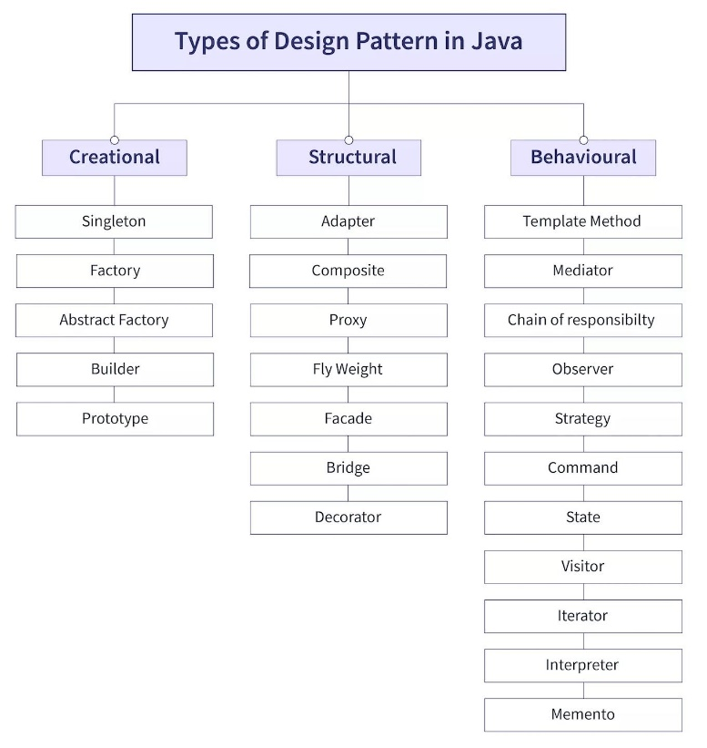
Design pattern types:-

Slide 6
Desigin pattern used :-
factory
observer
Builder
adapter
singleton

Slide 7
Project Description :-
The application manages various aspects of a medical practice including patient data, doctor schedules, appointments, and medical records. The goal is to create a user-friendly GUI application that facilitates efficient data management.

Slide 8
Singleton pattern :-
Benefits of use singleton :-
1-Resource Management: Prevents multiple instances that could waste resources .
2-Consistency: Ensures all parts of the application use the same instance, avoiding conflicts or inconsistencies
3-Global Access: Provides a centralized way to access shared resources.
4-Thread Safety: Proper implementation ensures safe access in multithreaded environments.
5-Simplified Maintenance: Changes to the singleton instance apply globally without affecting other parts of the application.

Slide 9
Used singleton in project :-
Patient Database Manager: Ensures a single instance for managing patient data.
Appointment Scheduling System: Ensures consistent checking and assignment of appointment slots.

Slide 10
Factory :-
The factory design pattern is a constructor design pattern that provides an
interface for creating objects without specifying their exact class. Instead of
creating objects directly using the new keyword, the factory pattern
delegates the responsibility of creating instances to a separate factory class
or method. This enhances flexibility and extensibility in your code.
Type of factory design pattern
1-Simple Factory
2-Factory Method
3-Abstract Factory

Slide 11
Advantages of Factory Design Pattern :-
1-Decoupling :-
The client code is decoupled from the concrete classes, reducing dependencies and enhancing flexibility.
2-Reusability :-
Centralized object creation logic can be reused across multiple clients or projects.
3-Scalability :-
Adding new product types becomes easier, as you only need to add new classes and update the factory logic without modifying the client code.
4-mproved Maintainability :-
Centralizing object creation simplifies the codebase and makes it easier to maintain and modify.
5-Enhanced Testability :-
Mock objects or different product types can be injected easily for testing purposes.
2

Slide 12
Use Cases :-
1- When the exact type of object to create depends on runtime conditions.
2-When creating an object is a complex process involving multiple steps.
3-When there’s a need to manage and reuse shared or common object instances.
4-To implement frameworks or libraries with extensible behavior.
Used factory in project :-
Medical Records Factory: Creates different types of medical records (Patient History, Prescriptions, Lab Results).
Doctor Specializations Factory: Instantiates doctor objects based on specialty (Cardiologist, Neurologist, General Practitioner).

Slide 13
Observer design patter :-
The Observer Design Pattern is a behavioral pattern that allows one object (the subject) to notify other objects (observers) about changes to its state.
This pattern is particularly useful in situations where a change in one object needs to be reflected across multiple dependent objects without tightly coupling them.
Key Components :-
Subject: The object that holds the state and notifies observers about
changes.Observers : The objects that watch the subject and get notified of any state changes.

Slide 14
How it work :-
Subject: Maintains a list of observers and provides methods to add or remove observers.
Observers: Implement an interface with an update method that gets called when the subject's state changes .
Notification: When the subject's state changes, it calls the update method on all registered observers.

Slide 15
Advantages of using Observer :-
1. Decoupling Between Subject and Observers
2. Dynamic and Flexible Relationships
3. Automatic Updates
4. Promotes Reusability
4. Promotes Reusability
6. Improved Maintainability
6. Improved Maintainability
8. Supports Open/Closed Principle

Slide 16
Common Use Cases:-
Common Use Cases:
**Used for updating the GUI elements in response to data changes.
Event-driven systems: GUIs, notification systems, or event logging.
Data synchronization: Keeping data consistent across multiple components or systems.
Broadcast communication: Messaging systems or pub/sub frameworks.
Real-time updates: Dashboards, live feeds, or streaming data.

Slide 17
Adapter design pattern :-
The Adapter Design Pattern is a structural design pattern used in software
development to bridge the gap between two incompatible interfaces.
It enables systems, components, or classes with different interfaces to work
together by providing a "wrapper" or "adapter" that translates one interface into
another.

Slide 18
Advantages of the Adapter Pattern :-
1-Reusability
2-Flexibility
3-Decoupling
4-Scalability
8: Use Cases :-
Integrating legacy and modern systems.
Connecting applications with different interfaces.
Interfacing with third-party libraries or external services.

Slide 19
How the Code Works :-
The client (Main) calls the target interface.
The adapter (MedicalClinicAdapter) translates the request to the external system.
The external system (ExternalBookingSystem) processes the request and returns the result.

Slide 20
Builder design pattern :-
what is builder design pattern :-
The Builder Design Pattern is a creational pattern that provides a way to construct a complex object step by step.
It separates the construction of a complex object from its representation so that the same construction process can create different representations.

Slide 21
Advantages of the Design :-
Readability:
The fluent interface makes object construction clear and intuitive.
Validation:
Mandatory fields are enforced during the build process.
Reusability:
The reset method or creating new builders allows for multiple objects to be constructed easily.
Maintainability:
Adding new fields requires changes only in the builder.

Slide 22
Why Use It :-
Avoids large constructors with numerous parameters.
Ensures immutability of the constructed object.
Enforces validation during the build process

